Slide 1
UNITED SOCIETY PARTNERS IN THE GOSPEL

Slide 2
Mission to.......
.......or mission with?
What is a modern mission agency about?
Canon Edgar Ruddock

Slide 5
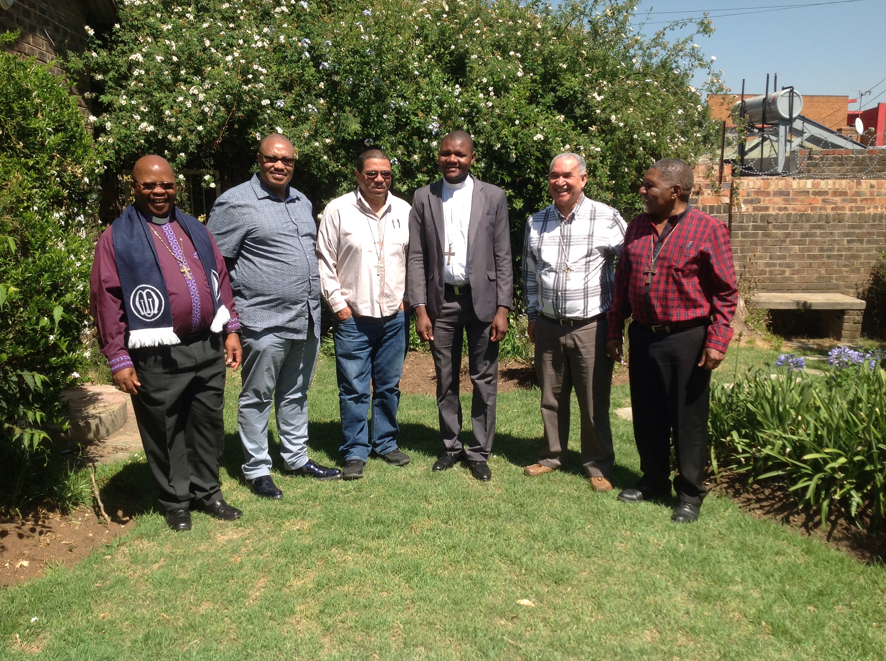

Slide 6
Leadership and Change
Community
Transformation
Pioneering
emPowering
Prophetic
Incarnational
Parental
Parochial
Salvationist
Dualistic
Church
Leader
People

