Slide 2
Why Refugees ?
Syria in its fifth year of conflict
There is no sign of the end of the war
Incidents of child labour and child marriage have increased since the start of the war
They are desperate - ‘In Syria we are now used to quick deaths that come with bombs or shootings, but what we are experiencing in these journeys is a slow death.’ Syrian refugee

Slide 3
Refugees in neighbouring countries.
The UN camps in Jordan, Lebanon and Turkey are simply unable to respond appropriately with the limited funds that Western governments have allocated.
The sheer numbers of Syrian refugees cannot be contained by underfunded and inadequate camps.
The refugees cannot return to their homes, so they must move.

Slide 4
The size of the problem – September 2015
About 350,000 refugees and migrants have entered the EU borders this year so far.
235,000 arrived in Greece.
Nearly 115,000 in Italy.
About 2,100 arrived in Spain.
More than 2,000 are known to have drowned trying to cross by sea. (International Centre for Migration, )

Slide 5
The size of the problem – November 2015
An estimated 700,000 refugees have arrived in Greece so far this year (UN 17/11/15).
Of this number, an estimated 190,000 are children.
In Greece, up to 7,000 refugees are arriving each day.

Slide 6
The size of the problem – November 2015
In October, more than 218,000 migrants and refugees crossed the Mediterranean to Greece – nearly the same number that made the crossing during the whole of 2014 (UN).
The island of Lesvos alone has seen 300,000 refugees passing through this year. The population of Lesvos is normally 27,000.

Slide 7
The worst humanitarian crisis in Europe since the Second World War.

Slide 8
Travel to Greece.
Desperate families have been travelling overland to the Turkey coast, then taking boats to Greece, hoping eventually to find refuge and a home in Europe.
The sea crossing is treacherous. Amnesty International says, in the first ten months this year, over 450 refugees and migrants died or went missing in shipwrecks.

Slide 9
In Greece
The current economic austerity measures in Greece have been impoverishing people in Athens and the country more widely.
Both the government and the population at large have severely depleted resources and are seeking to care for Greek citizens going hungry while also coping with this massive influx of refugees and migrants.

Slide 10
The needs
Families arrive in Greece feeling exhausted.
Many are in urgent need of medical care.
Migrants (especially children and young people ) are very vulnerable to human trafficking .
The United Nations’ refugee agency has identified the priority needs for the refugees as food, water, shelter, hygiene and health, and winter clothing.

Slide 11
What is Us. doing?
Us. supports a project which is providing:
In Athens, shelter to 5,000 refugees over the next six months, with priority going to children, the elderly and people with poor health. Also, bundles of winter clothes for 10,000 refugees.
On the islands, 2,500 tents, 10,000 sleeping bags, 60,000 food parcels, and 66,000 hygiene kits for adults and babies.

Slide 12
The Diocese in Europe
The Diocese in Europe has committed to the several initiatives to help migrants and are in partnership with the Greek Orthodox Church and other agencies.
The Diocese has asked Us. to be the means by which donations from the UK can be consolidated for sending on to support their work.

Slide 13
The Diocese in Europe
On the Island of Lesvos, the Diocese are supporting an initiative based at the Pharos Lighthouse to help refugees who arrive by boat from Turkey. They are wet, tired, cold and hungry, and many are distraught or need medical attention.

Slide 14
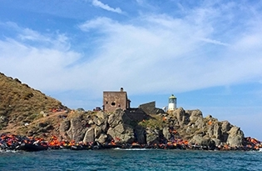
Reception Centre for refugees at the lighthouse on Lesvos

Slide 15
The Diocese in Europe
On the Island of Samos, a church hostel is caring for 600 refugees, many of whom have medical needs.
The hostel is mostly supporting Iraqi and Afghan refugees.

Slide 16
The Diocese in Europe
In Athens, the church is working with the Salvation Army to provide food, water and medicine to refugees who congregate in local parks.

Slide 17
What next?
The refugees typically stay in Greece for six to eight days.
They are registered and processed.
Then they continue their journey north.

Slide 18
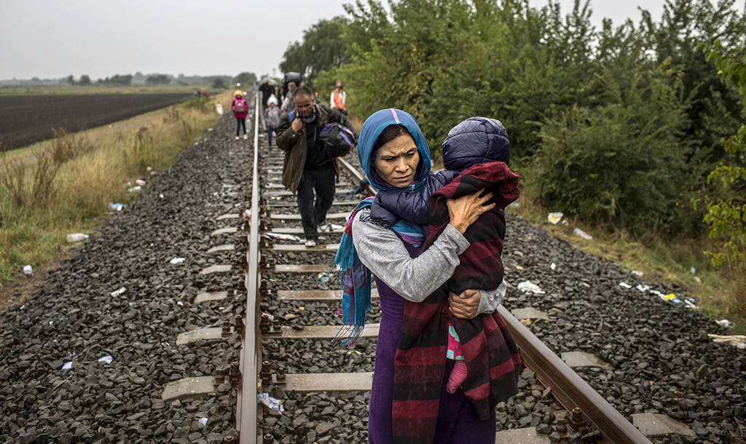
Refugees follow train tracks en route to western Europe.
(Panos Pictures/Lianne Milton)

Slide 19
Pray for refugees as you light your Advent candles with our Advent prayer card.

Slide 20
For more information or to donate www.weareus.org.uk

